Slide 1
Chapter 2 Section 2
The HCS12 Memory Map

Slide 2
Memory Space Allocation in the HCS12
The HCS12 has 64 Kbytes of directly accessible memory space as follow:
Register Space
Dedicated to I/O and Special Function Registers (SFR) such as timers, serial communication, ADC, etc.
I/O and SF registers are 8 bit
The amount assigned may vary widely from chip to chip even among members of the same family.
Sometimes a small as 64 bytes
Addresses start at 0000

Slide 3
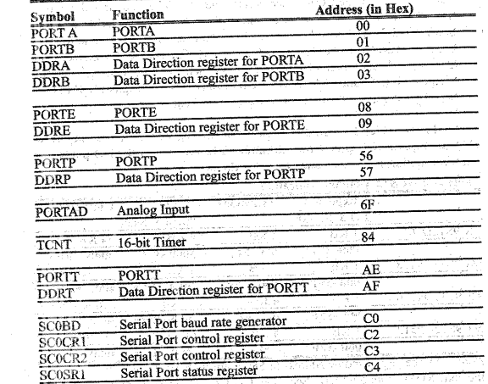
Partial List of MCHC9I2B32 Register Addresses

Slide 4
Data RAM Space
Capacity ranges from 128 bytes to several KB
Used for data variables, scratch pad and stack
Accessed by microcontroller instructions
This is Read/Write memory
Larger sizes will result in more difficulty on the programmers part in managing the RAM locations if programming in assembly language
Use of C compilers will simplify this, and this the reason that we need the larger RAM capacities.
The RAM has a byte size width
Please contain your excitement until section 2.8

Slide 5
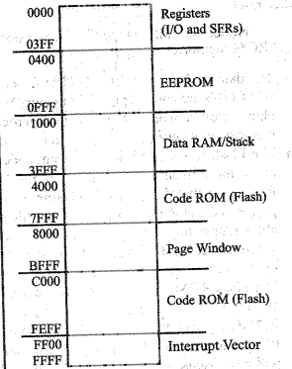
MC9S12Dx256 Memory Allocation

Slide 6
EEPROM Space
Range of 128 to several thousand bytes
Varies widely from chip to chip
Sometimes used for code storage
Most often used for storage of critical data

Slide 7
Code ROM Space
Capacity ranges from a few to several hundred KB
Used for program storage
Usually in Flash memory
Under control of the program counter (PC)
Might also be used for storage of static data such as ASCII data strings
ROM greater than 64K will be accessed by page swapping

Slide 8
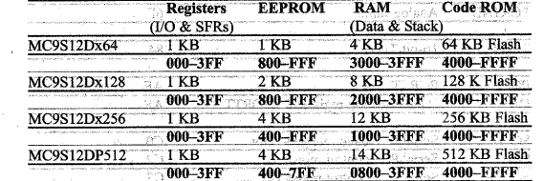
HCS12 Memory Allocation

Slide 9
Differences in the Microcontrollers
Many Microcontrollers have no EEPROM
We need to secure critical system data
Flash ROM is programmed and erased block by block
Block size is 8, 16, 32, or 64 bytes
This is not the case with EEPROM which is byte by byte programmable and eraseable.

Slide 10
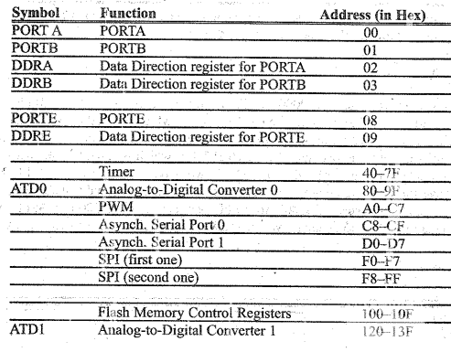
HCS912DP512 SFR Addresses

Slide 11
Memory Address Verification Example
Verify the memory address for the following sections
Registers 1 KB starting 000 hex
Ram 12 KB starting 1000 hex
Flash Rom 32 KB starting 8000 hex
Solution
Register 1024 converts to 400 hex <= 0000 to 3FF
Ram 12,288 converts to 3000 hex <= starting address is 1000 hex implies 1000 to 3FFF
Flash Rom 32 KB converts to 8000 hex <= starting location 8000 hex implies 8000 to FFFF

Slide 12
Dividing Memory Space into 4 Equal Sections
Range is 64 KB divided by 4 will result in 4 equal 16 KB sections
3FFF is 16 KB
Division 1 0000 to 3FFF for Registers, RAM and EEPROM
Division 2 4000 to 7FFF for Fixed Code ROM
Division 3 8000 to BFFF for page window
Division 4 C000 to FFFF for Fixed Code ROM

Slide 13
Accessing Memory Beyond 64 K
One of the most important registers in the microcontroller is the program counter (PC)
This is incremented each time the CPU fetches an instruction from the program ROM
The PC is 16 bits wide, meaning that only 64 K or 2^16 may be accessed.
The result is that we will need to used page swapping to access memory beyond 64 K.

Slide 14
Where the HCS12 Wakes up when it is Powered up
In the HCS12 family this is $FFFE
Power up is accomplished by applying required Vcc or activating Reset Pin
This means that the address of the first instruction must be stored at $FFFE
Locations $FFFE and $FFFF belong to the interrupt vector.
In some trainers the interrupt vector table is redirected to prevent users from overwriting the bootloader address

Slide 15
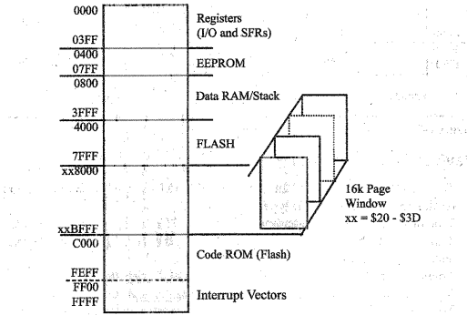
MC9S12Dx512 Memory Allocation Using Page Window

Slide 16
Single Chip and Expanded Modes in the HCS12
HCS12 can work in several modes
Most widely used are single chip and expanded
In single chip mode, all on chip memories are visible to the programmer and their addresses are set to fixed locations upon reset.
In expanded mode one may connect to external memories of RAM and ROM and remap the on chip memories to different address locations
In some development boards the HCS12 uses the external RAM for code development to avoid obsolescence of the Flash ROM

Slide 17
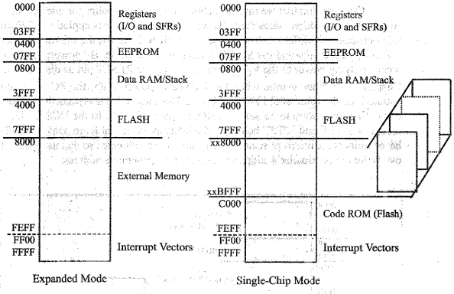
Single Chip vs Expanded Mode in HCS12

